Slide 1
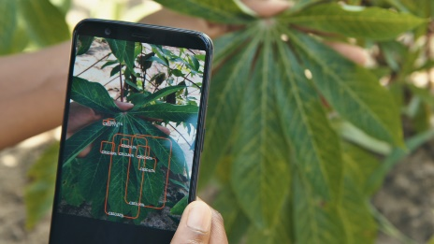
What do they
THINK & FEEL?
Whether the system will find all the diseases of all plants
Does automated system helps in identifying disease
How AI helps in reducing the loss by disease
Does it helps in the development of the life style of farmers
Does it prevent from bacterial infection
Recommends the fertilizers
They identify the diseases by taking photos of leaves
What do they
HEAR?
What do they
SEE?
Interactive portal for farmers to upload images
Whether they can find disease at earlier stages
To demonstrate the quantity of fertilizer to be given
Disease identification
Farmers need the recommendation of fertilizer based on the disease
User friendly platform to access like application with accurate results
What do they
SAY & DO?
Good internet connectivity along with the knowledge of usage
Not organic and spending large amount for fertilizer
Prevention of risk and minimum risk
Easy identification of disease and quick response they get
PAIN?
GAIN?

